Slide 1
Tools For Data Science
Dr Gerald Gurtner
12 Sept. 2019
Engage summer school, FTTE, Belgrade

Slide 2
The data scientist’s job
Data scientist has three tasks:
Choosing and preparing data
Using scientific tools to extract high-level knowledge (exploration, modelling, analysis)
Communicate the results
Two sides covered here:
Methodology (experimental setup, modelling choice, data analysis), algorithmic choices
Practical tools, implemented algorithms.

Slide 3
Data Preparation

Slide 4
Storing and preparing data
Storing data:
  Find the best tool for your data (see next part). Are they organized in tables with relationships between them? Is it big?
Preparing data:
  Check data format
  Track inconsistent data: look at distributions of variables, track outliers (see next slide), cross-check data by different means if possible.
  Data fusion:
    cross field between database if needed,
    choose if you can live with default values for missing fields (‘outer/left’ join) or if you need to remove data (‘inner’ join),
    make sure that you do not lose too much data, understand the possible biases.

Slide 5
Preparing simulations

Slide 6
Prepare input data
Select interesting fields.
Isolate them from primary source (different files, different databases).
Version the data! Reproductibility is key to science!
Optimise input for big models: use different tables/files, find out which fields are used more heavily etc.

Slide 7
Develop and run model (ABM, Monte-Carlo)
Estimate the computational complexity of the model.
Find the right language for it.
  Heavy load ➔ consider low-level language.
  Light computation ➔ high-level language.
  Agent-based models ➔ OO language, dedicated framework.
Find the right (stable) libraries for your problem. Don’t recode something which has been done unless there is a good reason. Stackoverflow & Github are your friends!
Develop your own tools if needed (reusable functions etc).
Prepare data flow, input and output. Prepare a parameter file, as easy to read as possible.

Slide 8
Develop and run model (ABM, Monte-Carlo)
Organise the simulations:
Choose carefully the combination of parameters to test (part of your experimental setup…),
If sampling continuous data, start with small samples.
Do running time tests, extrapolate.
Estimate the number of realisations for stochastic models to have significant results.
Keep a log of the simulations.
When code stable, optimize code IF NEEDED, starting with low-hanging fruits (obvious bottlenecks).

Slide 9
Analysing data

Slide 10
Exploring variables independently
Start by exploring each variable independently:
Compute typical behavior: mean, median.
Compute dispersion: standard deviation, 25-75 percentiles.
Plot distributions, try to understand why they look the way they look.
Compute and understand outliers (using z-score for instance). For dynamical data:
Estimate stationarity (e.g. with moving mean and std), spot trends. Is the distribution at equilibrium?
Compare ensemble mean to time mean.
Consider detrending the data. Ex: daily traffic:
  Compute ensemble mean at a given time.
  Substract ensemble mean to each day.

Slide 11
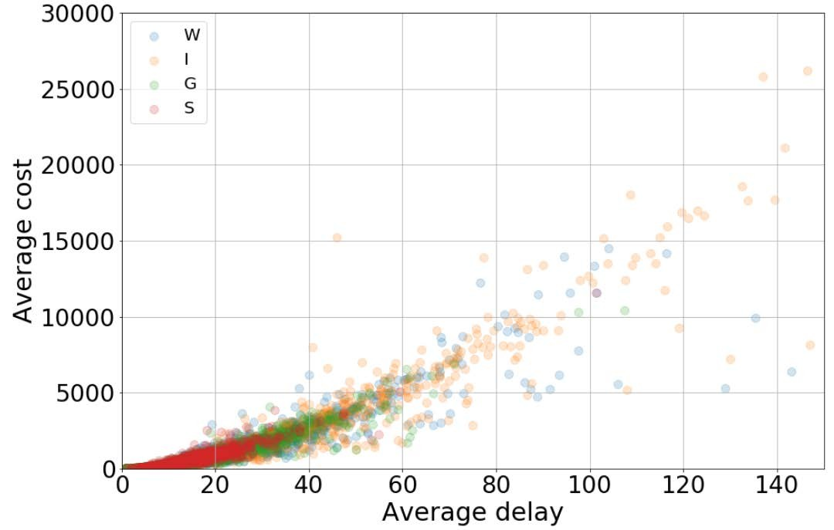
Exploring relationships between variables
Understand the relationships between pairs of variables:
Compute and analyse correlations: correlation matrix (+significance thresholds) etc.
Use partial correlations coefficients on interesting variables.
Do scatter plots between pairs of variables.
Spot non-linear correlations with scatter plots.
Dyn.: consider computing partial corr., controlling for time

Slide 12
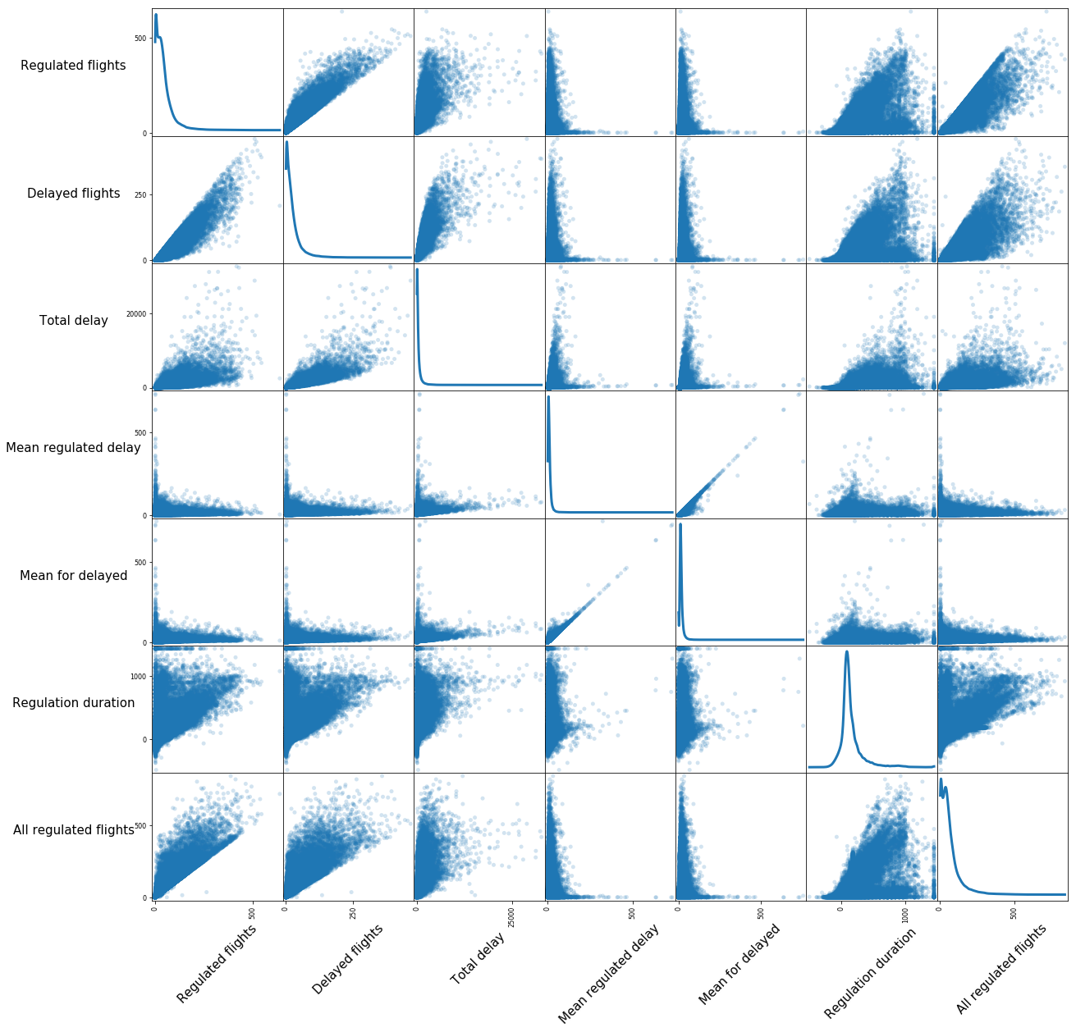
Exploring relationships between variables

Slide 13
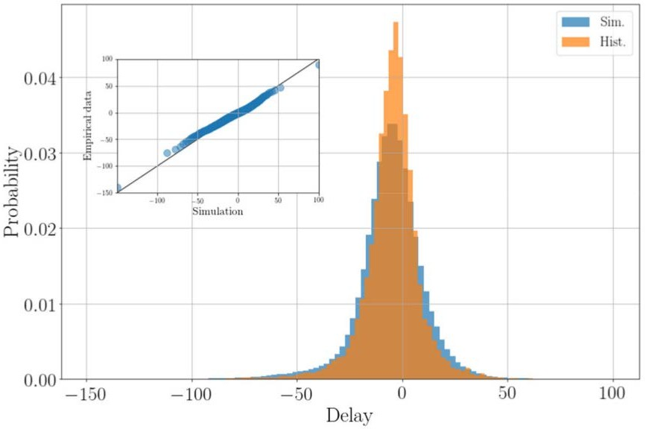
Analysing data (experimental results, empirical data)
Standardise your data for analysis (remove mean, divide by std)
For ordinal variables, use simple regressions on pairs of variables.
Compare distributions between values of independent variables.
Compute QQ plots

Slide 14
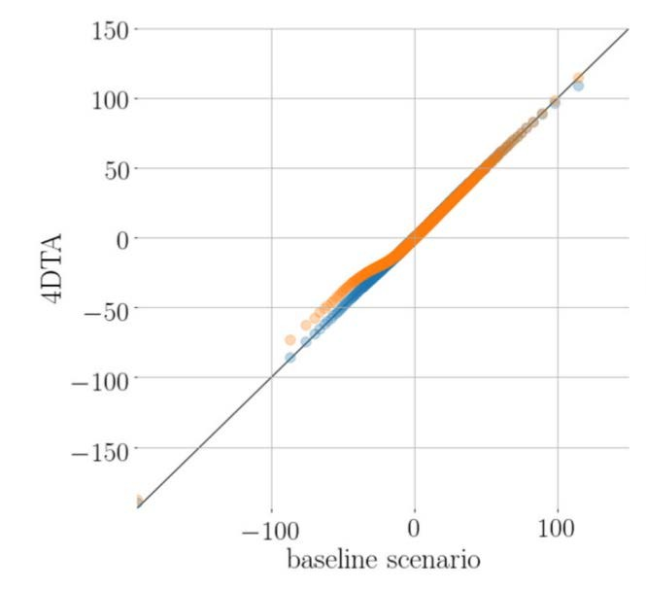
Analysing data (experimental results, empirical data)

Slide 15
Analysing data (experimental results, empirical data)
Depending on your hypotheses, find adequate statistical tests:
  Exact test?
  Bootstrapping, permutation?
  Non-exact tests (chi2, F-test, etc…).
  Decrease p-value for multiple-hypotheses tests (Bonferroni…)!
Build confidence intervals (e.g. with bootstrapping)
Don’t discard negative results!

Slide 16
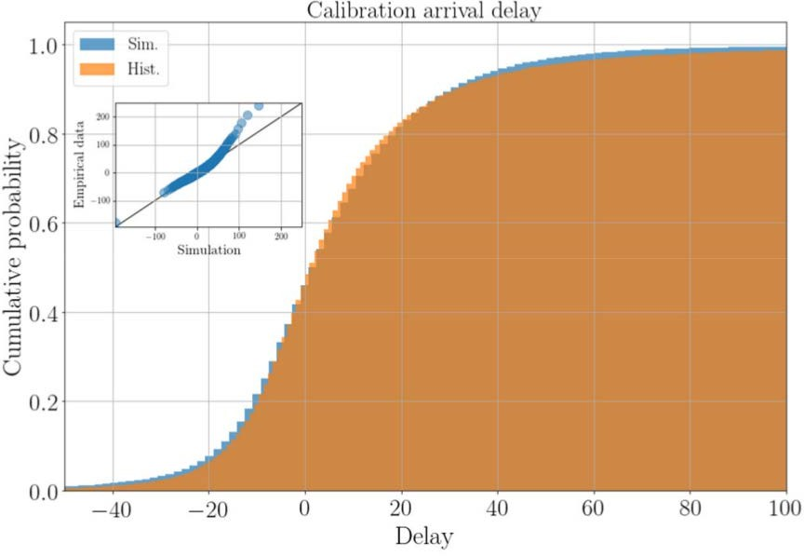

Analysing data (experimental results, empirical data)
Ex.: Kolmogorov-Smirnov test

Slide 17
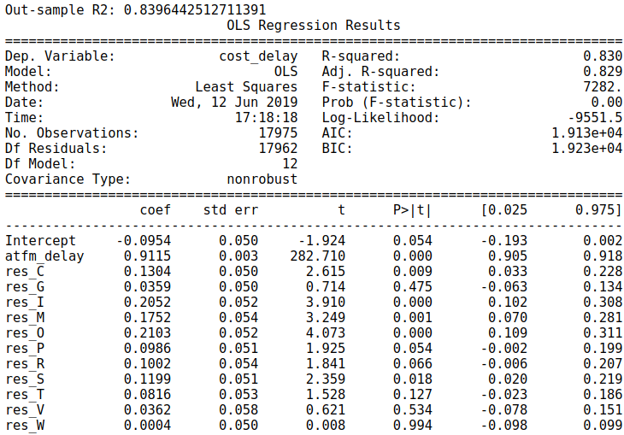
Analysing data: data modelling
Divide your data in two sets (randomly selected), e.g. 75%/25% for training and test data.
Look at literature to find out which model would be relevant (part of your experimental plan…).
Start with a simple model like ordinary least square. Include dummy variables for categorical variables to test their impact. Discard weak variables.

Slide 18
Analysing data: data modelling
Train your chosen model, start with model as simple as possible (few leaves/neurons/parameters)
Control for underfitting on training data (e.g. R) and overfitting on test data:
  Compute “in-sample” score
  Compute “out-sample” score.
Compare with OLS. Play with parameters.
Make prediction on new data. Check consistency, compare with other models if possible.
Iterate and improve!

Slide 19
Analysing data: clustering
Find the ‘right’ algorithm:
  network data?
    Yes ➔ community detection algorithms. Infomap, modularity, OSLOM.
    No ➔ clustering algorithms. K-mean, mean-shift etc.
  Fixed number of clusters (K-means)? Clusters can overlap (OSLOM)?
Find the right “distance” function (when non-network). Start with something simple. Ex. with trajectories:
  Differences in flight plan total distances.
  Maximum lateral distances.
  Etc…

Slide 20
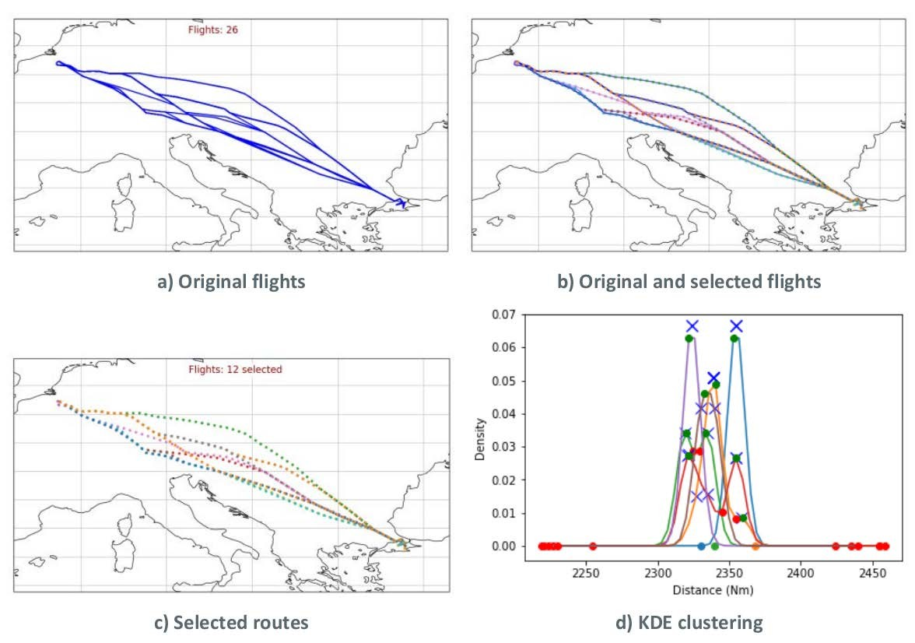
Analysing data: clustering

Slide 21
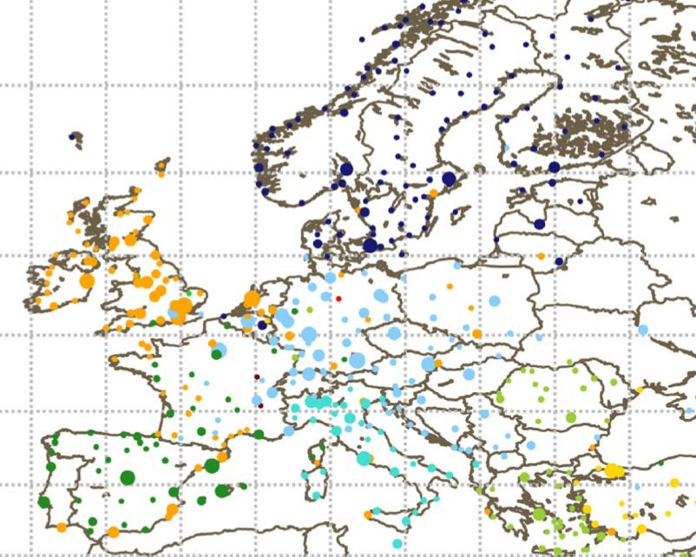
Analysing data: clustering

Slide 22
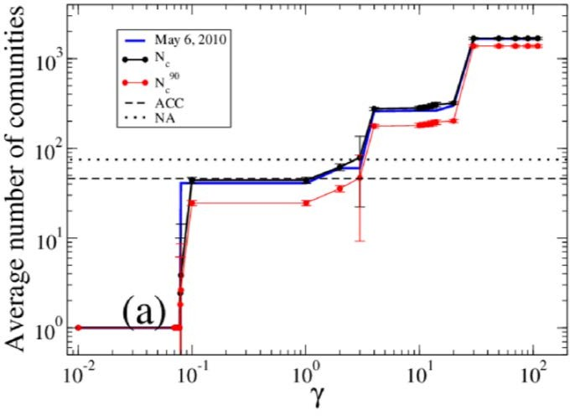
Analysing data: clustering
Be aware of the scale: most algorithms have a natural, ‘biased’ scale.
(modularity based)
Test robustness: modify input data, modify distance function.
Use proper metrics to compare partitions: rand index, mutual information etc.

Slide 23
Show data
Three golden rules:
target your audience,
don’t mislead the audience,
less is more (usually).

Slide 24
Tools for data science

Slide 25
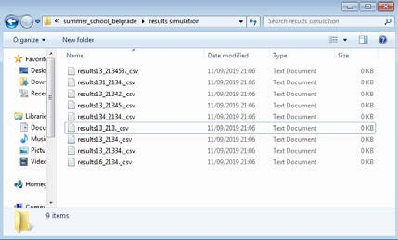
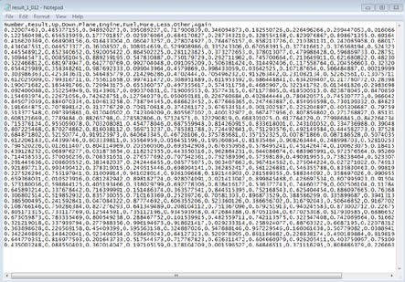
Data storage
File system
  Advantage
    Easy to use
    Easy to output/input from models
    Portable
    Easy backup
    CSV, etc.
  Disadvantages
    Hard to scale
    Hard to process
    Hard to join with other data
    Difficult to maintain
    Difficult for sharing/security
    Hard to manipulate (change, update)

Slide 26









Data storage
File system
  Linux file commands
    cat
    more
    grep
    sed
    head
    tail
    split
    pipe |
    man
  awk
  open office (more rows)
  Sublime text/Atom (to check files)
Python / pandas might be useful (see next slides)
Keep track of files in folder
Use shell scripts (e.g. process all files in a folder)

Slide 27
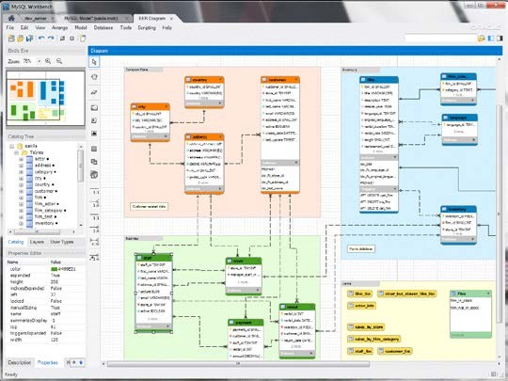
Data storage
Relational database
  Advantage
    Structured Query Language (SQL)
    Easy to join data
    Server based solutions
    Secure access
    View on data
    Explore data with interface
    Structure of database (UML)
    API for programming languages
    ACID principle (Atomicity, Consistency, Isolation, Durability)
  Disadvantages
    Might be difficult to scale
    Slower access
    Dynamic definition of data structure
    Harder to keep traceability
    Server configuration for perfomances

Slide 28









Data storage
Relational databases
MySQL
MySQL Workbench
Sequel Pro
PostreSQL
MariaDB
SQLite
Primary keys
Indexes
Numerical ids
Foreign keys
Configuration of server parameters
Creation database structure

Slide 29
Data storage
Non-Relational database (NoSQL)
  Advantage
    Address the scalability problem characteristic of SQL
    Schema-free and built on distributed systems
    Access time
    Massive volumes of new, rapidly changing data types
    Object-oriented programming
    Dynamic schemas
    API
  Disadvantages
    Relaxed ACID principles: eventual consistency (if there are no new updates for a particular data item for a certain period of time, eventually all accesses to it will return the last updated value)
    It may lead to data loss (quality of application code)
    Heterogeneity of systems (little uniformity among them)
    Lack of standardisation (maturity)

Slide 30









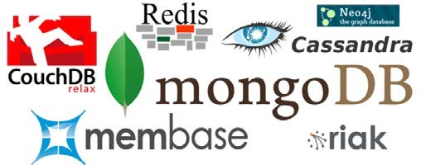
Data storage
Non-Relational databases
Different implementations / alternatives
Research online!
Apache CASSANDRA
Apache HBASE
mongoDB
Amazon Dynamo

Slide 31
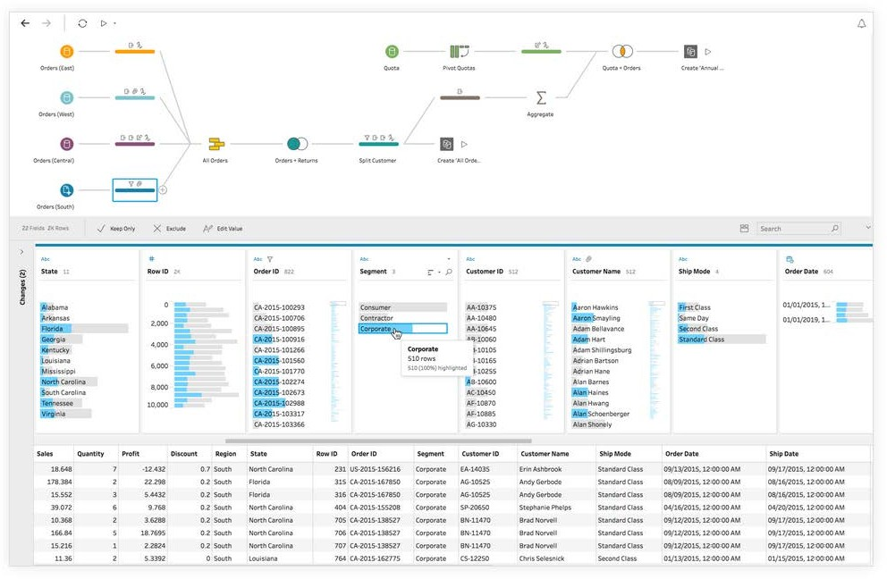
Data handling
Tableau (commercial): data fusion, correction, cleaning, and analysis

Slide 32
Data handling
Matlab (commercial, equivalent open-source: Sage, Scilab, Octave):
  Excellent at numerical analysis. Lots of libraries.
Excel! Open source Libreoffice can handle more rows.
Python tools (free, open-source):
  Jupyter notebook (interactive python shell).
    Easy to use and easy to share the results.
    Collaborative version from google.
  Pandas: build “dataframes”.
  Geographical data: cartopy, basemap, geopandas (built on pandas). Manage projections, distances etc.
  Big community, open modules, easy to learn.

Slide 33
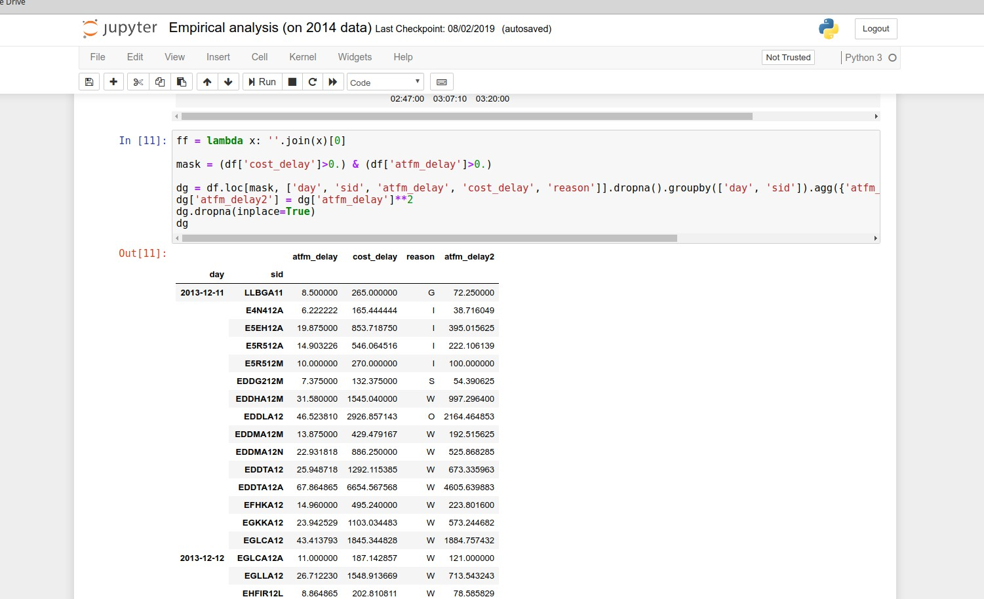
Data handling (jupyter)

Slide 34
Model development
Low-level languages for computational power: C/C++.
High-level languages for ease of use:
  Python:
    Advantages: easy to learn and use, massive numerical libraries, full power of a ‘real’ language,
    for simulations: simpy,
    for ABM: Mesa,
    for scientific tools (algebra etc): numpy, scipy,
    for database(s) interface: alchemy
    for file access (csv, excel, jason): pandas.
    multiprocessing : simple CPU parallelisation.
    Numba: GPU parallelisation. Rmk: on Windows, use Anaconda suite.

Slide 35
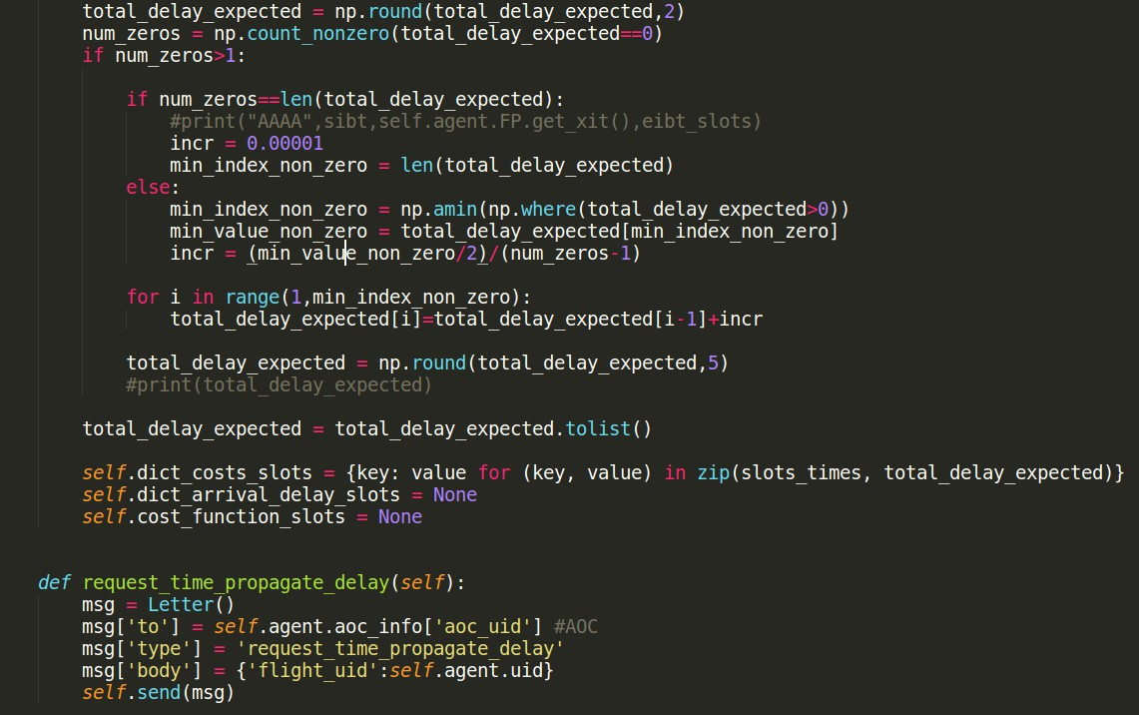
Model development

Slide 36
Model development
Java:
  Dedicated frameworks for ABMs (Java): Jade, Jadex.
  Faster than Python.
  Less obvious syntax, harder to learn.
  Not so used for data handling and data visualisation.
Don’t hesitate to use a version-control tool, like git. Quick to learn and very useful to keep track of changes, even if you develop alone. (rmk: free Github space for academics and students).
Use bash scripts (or python scripts…) or equivalent to run batch of simulations.

Slide 37
Data analysis/modelling
Python:
  pandas/numpy: can quickly extract standard statistics.
  scipy, scipy.stats: useful tools like z-scores.
  scikit-learn: more in depth analysis. Dedicated to machine learning.
  networkx: useful for network data. Can easily compute degree, strength, cliques etc.
  TensorFlow (from Google), Keras (using TensorFlow and theano): deep learning (or not…).

Slide 38
Data analysis/modelling
“R” (free, open-source):
  very focused on statistics,
  easy to learn and to use,
  lots of libraries.
Tableau, Matlab etc
Julia: new language designed for data science. Still young, but promising.

Slide 39
Data analysis/clustering algorithms
Python:
  Clustering (Kmeans, mean shift, etc): scikit-learn
  Community detection:
    Infomap: now usable with Python (and networkx)
    Simple modularity maximisation: include in networkx. More advanced capabilities in other non-standard library.
OSLOM: powerful algorithm, tool written in C and executed with a script

Slide 40
Optimisation
Look in the literature for guidance.
Find out the characteristics of the problem:
  Several variables?
  Bounded?
  Discrete optimization? Continuous?
  One minimum? Several?
  Computational load of a point estimation?
Good candidates (scipy.optimize, google_or, or pyomo modules):
  Basin-hopping, simulated annealing, genetic algorithm: good for unknown energy landscape. Long to converge.
  Gradient-based methods. Usually good for a unique minimum.
  (Mixed-)integer linear or quadratic methods. Deterministic.

Slide 41
Data visualisation
For most scientists working with Python, matplotlib is the way to go for graphs. Some improvements:
  Shapely: easily use polygons. Very useful for airspaces etc.
  Seaborn: statistical visualisations.
  Ggplot2: nice plots ☺.
  Plotly: non-open, API using D3.js under the hood ➔ interactive display. Drawback: has to connect to the server.
Google map Python (and other languages…) API.
Blender for 3D visualization (Python console).

Slide 42
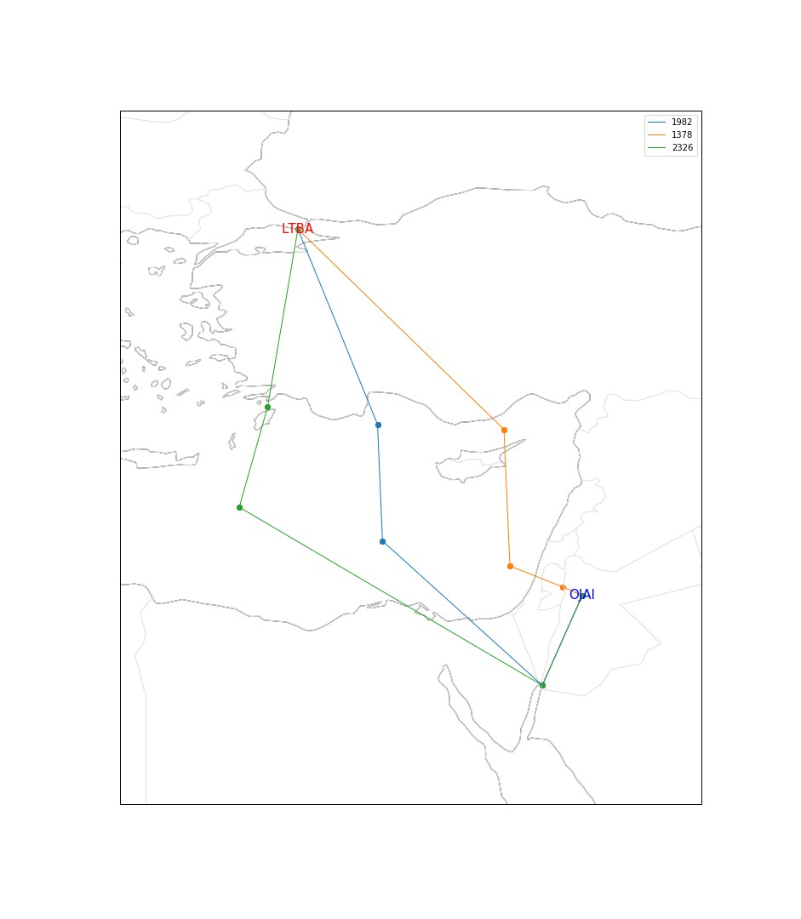
Data visualisation

Slide 43
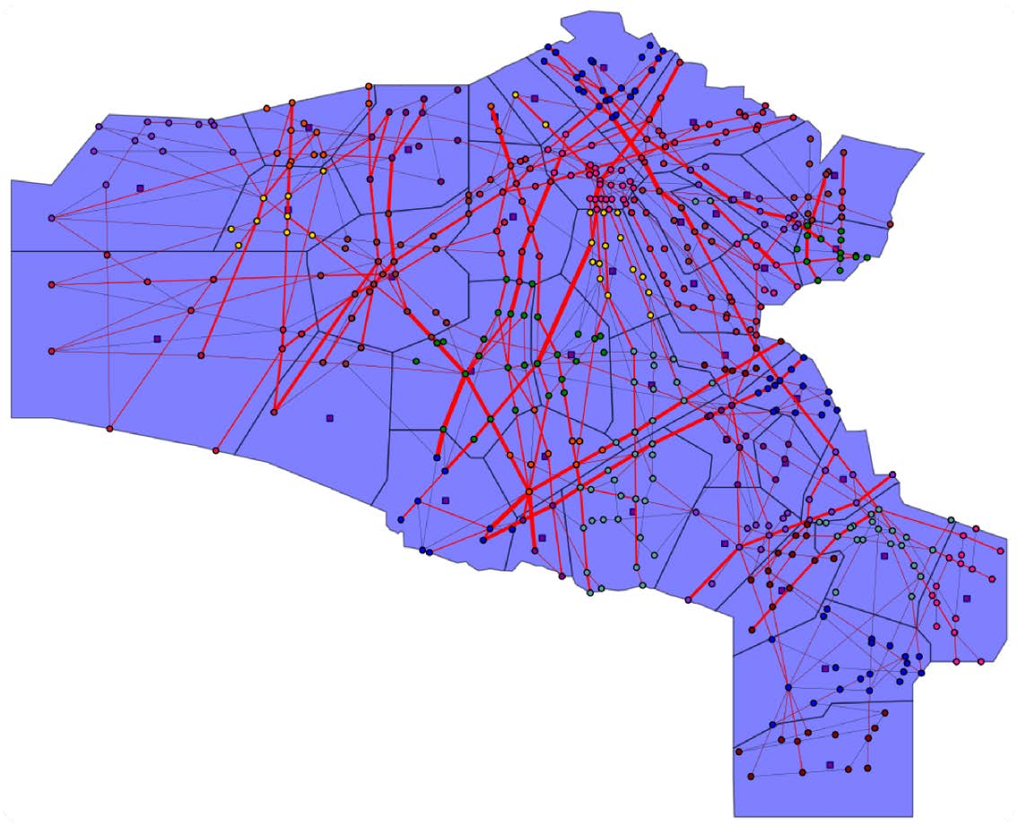
Data visualisation

Slide 44
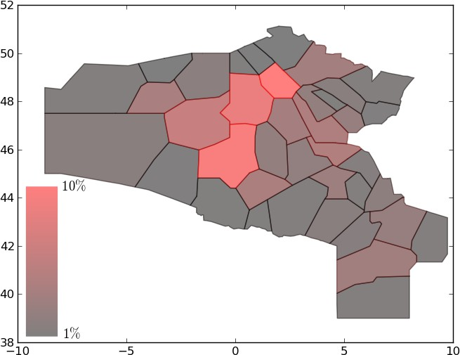
Data visualisation

Slide 45
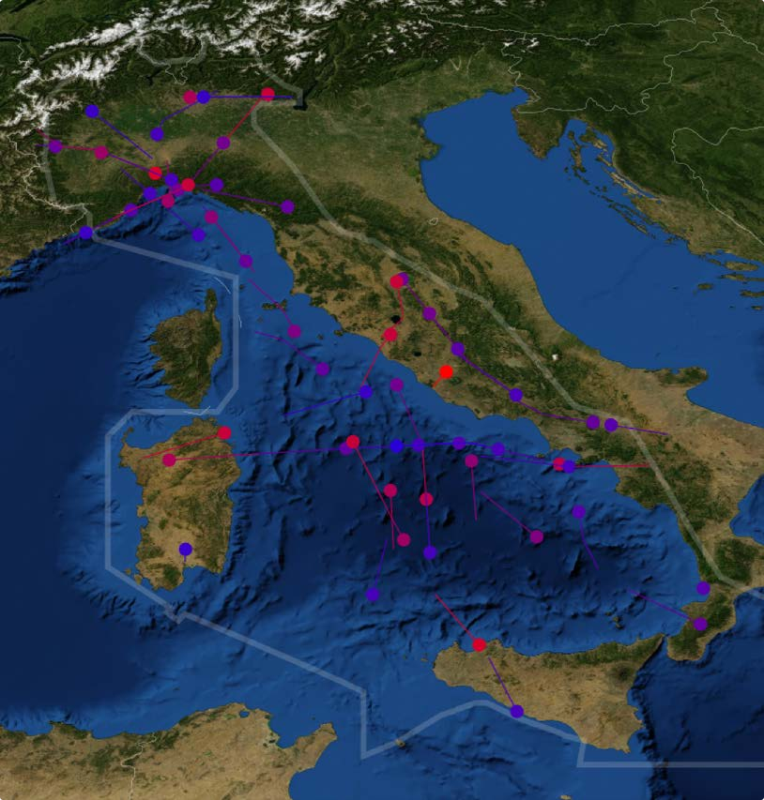
Data visualisation

Slide 46
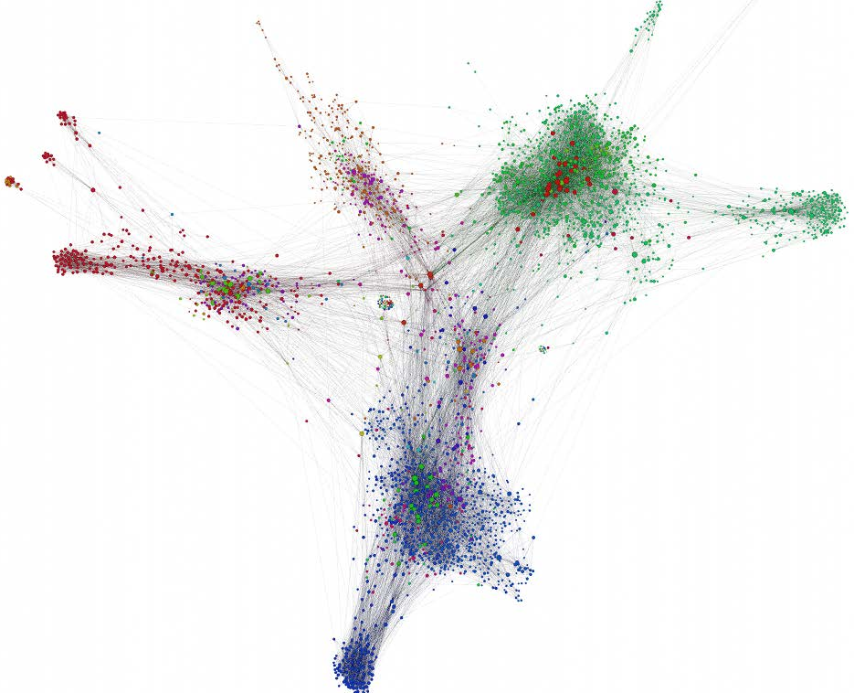
Data visualisation
D3.js (free): JavaScript library to do beautiful and interactive graphs.
Google Earth: accepts XML files to display polygons, trajectories etc.
Gephi (open source, free) for graphs/networks.

Slide 47
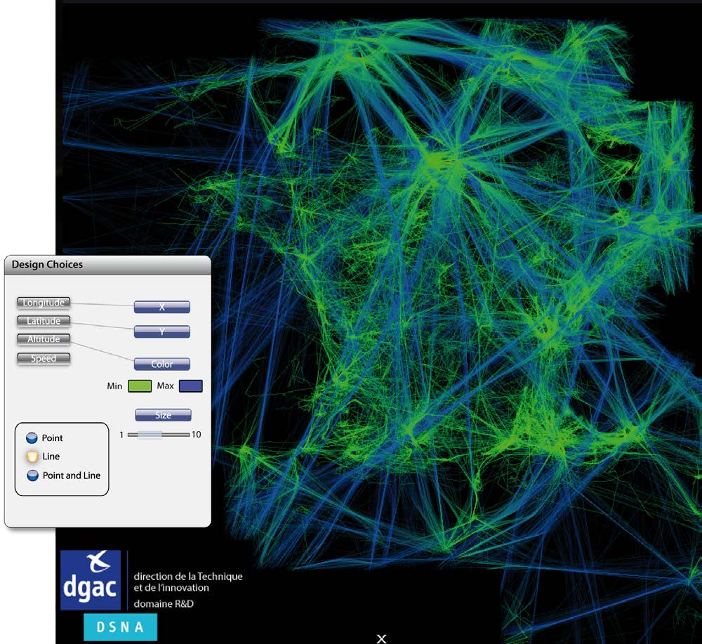
Data visualisation
FromDady: developed by ENAC.
Extremely quick, handles massive amount of data.
Excellent for trajectory data exploration: ‘brush’ ‘pick’, ‘drop’ functions.
Not open-source.
Remaining bugs.

